Slide 1
Database Systems
Lecture 2-Chapter # 14
DATABASE DESIGN THEORY AND NORMALIZATION
Alina Arshad
alina.arshad@nu.edu.pk

Slide 2
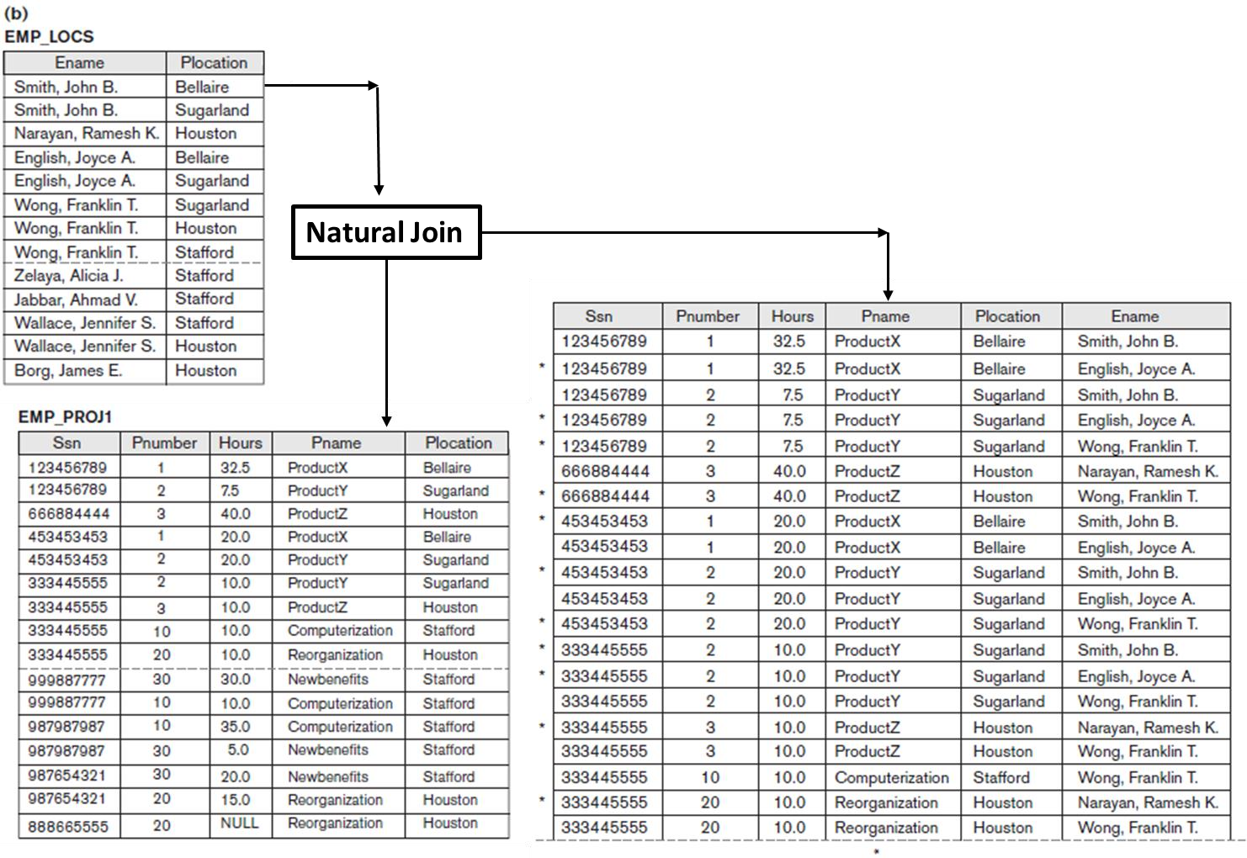
Generation of Spurious Tuples
Additional tuples that are not present in original table are called spurious tuples because they represent spurious information that is not valid.

Slide 3
Guideline 4
Design relation schemas so that they can be joined with equality conditions on attributes that are appropriately related (primary key, foreign key) pairs in a way that guarantees that no spurious tuples are generated.
Avoid relations that contain matching attributes that are not (foreign key, primary key) combinations because joining on such attributes may produce spurious tuples.

Slide 4
Spurious Tuples
There are two important properties of decompositions:
Non-additive or losslessness of the corresponding join
Preservation of the functional dependencies.
Note that:
Property (a) is extremely important and cannot be sacrificed.
Property (b) is less stringent and may be sacrificed.

Slide 5




Lossless Decomposition
Decomposition means dividing a table into multiple tables
Decomposition is lossless (or nonloss) if it is possible to reconstruct R from decomposed relations using JOINs.
Condition for lossless join when R was decomposed into R1, R2, … Rn.
R = R1 R2 R3 …. Rn, where means JOIN operation.
$$∞$$
$$∞$$
Lossy decomposition
R ≠ R1 R2 R3 …. Rn
$$∞$$
$$∞$$

Slide 6
Functional Dependencies
A functional dependency is a constraint between two sets of attributes from the database.
Definition.
A functional dependency, denoted by X → Y, between two sets of attributes X and Y that are subsets of R specifies a constraint on the possible tuples that can form a relation state r of R. The constraint is that, for any two tuples t1 and t2 in r that have
t1[X] = t2[X], they must also have t1[Y] = t2[Y].

Slide 7
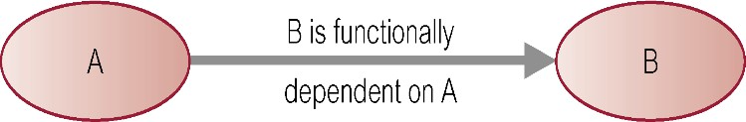
Defining Functional Dependencies
If A and B are attributes of relation R, B is functionally dependent on A (denoted A → B), if each value of A in R is associated with exactly one value of B in R.
X → Y holds if whenever two tuples have the same value for X, they must have the same value for Y
For any two tuples t1 and t2 in any relation instance r(R): If t1[X]=t2[X], then t1[Y]=t2[Y]
X → Y in R specifies a constraint on all relation instances r(R)
Written as X → Y; can be displayed graphically on a relation schema as in Figures. ( denoted by the arrow:).
FDs are derived from the real-world constraints on the attributes

Slide 8
Examples of FD constraints (1)
Social security number determines employee name
SSN → ENAME
Project number determines project name and location
PNUMBER → {PNAME, PLOCATION}
Employee ssn and project number determines the hours per week that the employee works on the project
{SSN, PNUMBER} → HOURS

Slide 9
Defining FDs from instances
Note that in order to define the FDs, we need to understand the meaning of the attributes involved and the relationship between them.
An FD is a property of the attributes in the schema R
Given the instance (population) of a relation, all we can conclude is that an FD may exist between certain attributes.
What we can definitely conclude is – that certain FDs do not exist because there are tuples that show a violation of those dependencies.

Slide 10
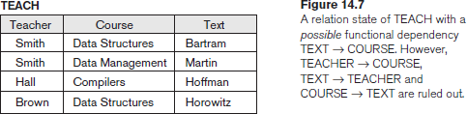
Determining Functional Dependencies

Slide 11
Important Definitions
Determinant
Refers to the attribute, or group of attributes, on the left-hand side of the arrow of a functional dependency.
Full Functional dependency:
Indicates that if A and B are attributes of a relation, B is fully functionally dependent on A if B is functionally dependent on A, but not on any proper subset of A.
{StaffNo, StaffName} → BranchNo
StaffNo → BranchNo
Transitive Dependency
A condition where A, B, and C are attributes of a relation such that if A → B and B → C, then C is transitively dependent on A via B (provided that A is not functionally dependent on B or C).

Slide 12
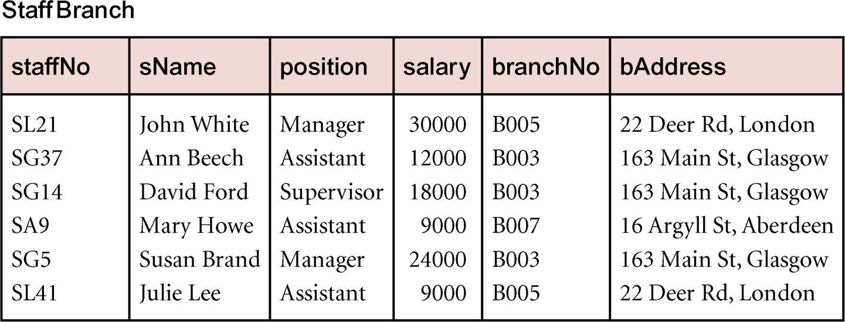
Example Transitive Dependency
Consider functional dependencies in the Staff-Branch relation
staffNo → sName, position, salary, branchNo, bAddress
branchNo → bAddress
Transitive dependency, branchNo → bAddress exists on staffNo via branchNo

Slide 13
Normalization of Relations
Definition. The normal form of a relation refers to the highest normal form condition that it meets, and hence indicates the degree to which it has been normalized.
Normalization of data: process of analyzing the given relation schemas based on their FDs and primary keys to achieve the desirable properties of
minimizing redundancy
minimizing the insertion, deletion, and update anomalies
Normal form:
Condition using keys and FDs of a relation to certify whether a relation schema is in a particular normal form

Slide 14
Normalization of Relations
2NF, 3NF, BCNF
based on keys and FDs of a relation schema
4NF
based on keys, multi-valued dependencies : MVDs;
5NF
based on keys, join dependencies : JDs
Additional properties may be needed to ensure a good relational design (lossless join, dependency preservation)

Slide 15
Practical Use of Normal Forms
The database designers need not normalize to the highest possible normal form (usually up to 3NF and BCNF. 4NF rarely used in practice.)
DE normalization:
The process of storing the join of higher normal form relations as a base relation which is in a lower normal form

Slide 16
Definitions of Keys and Attributes Participating in Keys
If a relation schema has more than one key, each is called a candidate key.
One of the candidate keys is arbitrarily designated to be the primary key, and the others are called secondary keys.
A Prime attribute must be a member of some candidate key
A Nonprime attribute is not a prime attribute that is, it is not a member of any candidate key.

Slide 17
Non-additive or Lossless Join Decomposition
If we decompose a relation R into relations R1 and R2,
Decomposition is lossy if R1 ⋈ R2 ⊃ R
Decomposition is lossless if R1 ⋈ R2 = R
To check for lossless join decomposition using FD set, following conditions must hold:
Union of Attributes of R1 and R2 must be equal to attribute of R. Each attribute of R must be either in R1 or in R2.
Att(R1) U Att(R2) = Att(R)
Intersection of Attributes of R1 and R2 must not be NULL.
Att(R1) ∩ Att(R2) ≠ Φ
Common attribute must be a key for at least one relation (R1 or R2)
Att(R1) ∩ Att(R2) -> Att(R1) or Att(R1) ∩ Att(R2) -> Att(R2)

Slide 18
Example
R (A, B, C, D)
FD: {A->BC} is decomposed into R1(ABC) and R2(AD) which is a lossless join decomposition as:
First condition holds true as Att(R1) U Att(R2) = (ABC) U (AD) = (ABCD) = Att(R).
Second condition holds true as Att(R1) ∩ Att(R2) = (ABC) ∩ (AD) ≠ Φ
Third condition holds true as Att(R1) ∩ Att(R2) = A is a key of R1(ABC) because A->BC is given.

Slide 19
Dependency Preserving Decomposition
If we decompose a relation R into relations R1 and R2, All dependencies of R either must be a part of R1 or R2 or must be derivable from combination of FD’s of R1 and R2.
For Example,
R (A, B, C, D) with FD set{A->BC} is decomposed into R1(ABC) and R2(AD) which is dependency preserving because FD A->BC is a part of R1(ABC).

Slide 20
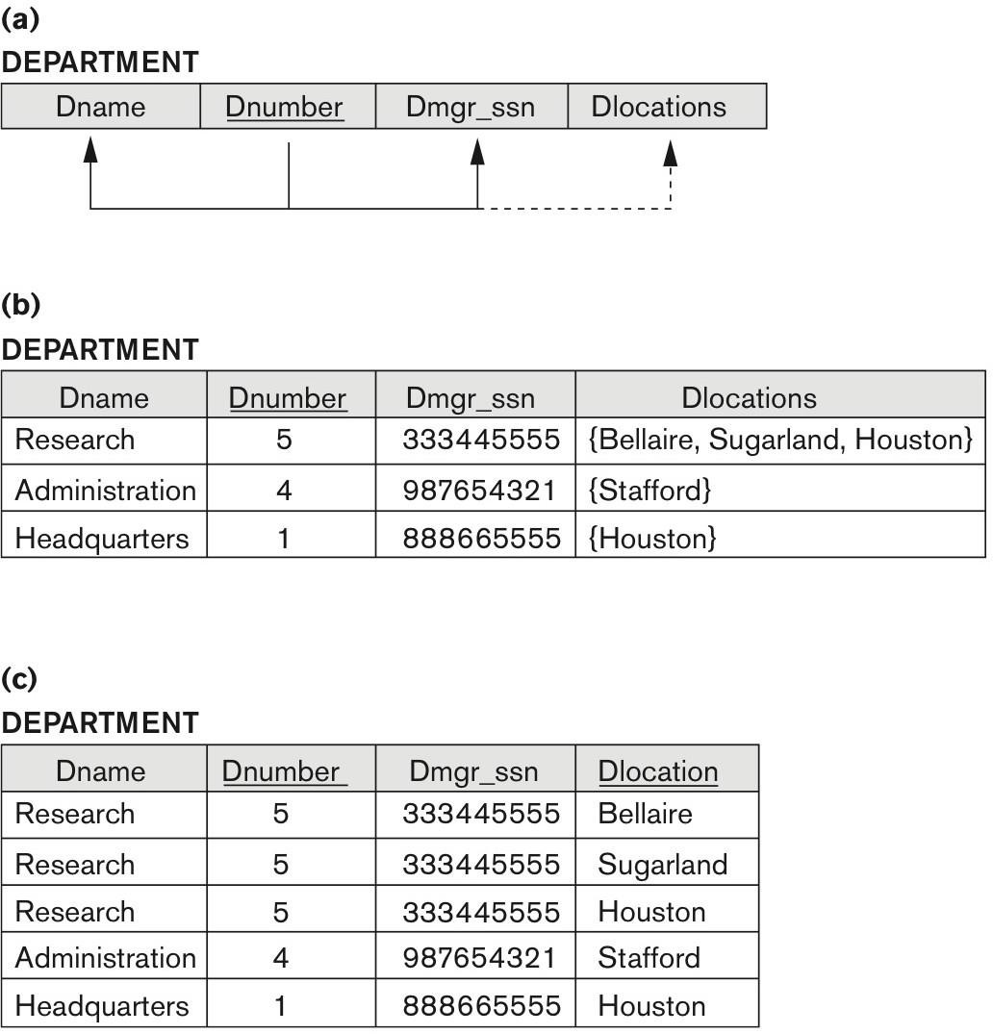
FIRST NORMAL FORM
It states that the domain of an attribute must include only atomic (simple, indivisible) values and that the value of any attribute in a tuple must be a single value from the domain of
that attribute.
Figure 14.9 Normalization into 1NF. (a) A relation schema that is not in 1NF. (b) Sample state of relation DEPARTMENT. (c) 1NF version of the same relation with redundancy.

Slide 21
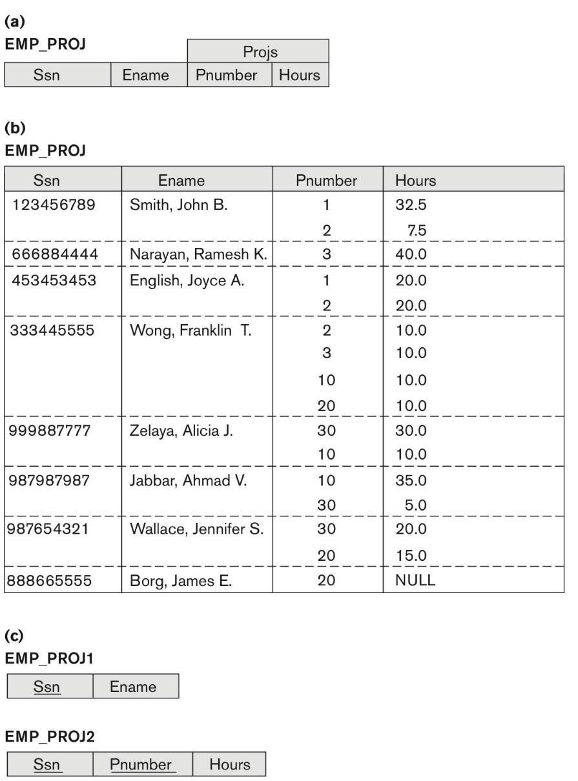
Normalizing nested relations into 1NF.
Figure 14.10 Normalizing nested relations into 1NF.
(a) Schema of the EMP_PROJ relation with a nested relation attribute PROJS.
(b) Sample extension of the EMP_PROJ relation showing nested relations within each tuple.
(c) Decomposition of EMP_PROJ into relations EMP_PROJ1 and EMP_PROJ2 by
propagating the primary key.

Slide 22
First Normal Form (1NF)
Repeating group = (propertyNo, pAddress, rentStart, rentFinish, rent, ownerNo, oName)
Unnormalized form (UNF)
A table that contains one or more repeating groups.
ClientNo | cName | propertyNo | pAddress | rentStart | rentFinish | rent | ownerNo | oName
CR76 | John kay | PG4 PG16 | 6 lawrence St,Glasgow 5 Novar Dr, Glasgow | 1-Jul-00 1-Sep-02 | 31-Aug-01 1-Sep-02 | 350 450 | CO40 CO93 | Tina Murphy Tony Shaw
CR56 | Aline Stewart | PG4 PG36 PG16 | 6 lawrence St,Glasgow 2 Manor Rd, Glasgow 5 Novar Dr, Glasgow | 1-Sep-99 10-Oct-00 1-Nov-02 | 10-Jun-00 1-Dec-01 1-Aug-03 | 350 370 450 | CO40 CO93 CO93 | Tina Murphy Tony Shaw Tony Shaw
Figure ClientRental unnormalized table

Slide 23
1NF ClientRental relation with the first approach
With the first approach, we remove the repeating group
(property rented details) by entering the appropriate client
data into each row.
The ClientRental relation is defined as follows,
ClientRental ( clientNo, propertyNo, cName, pAddress, rentStart, rentFinish, rent, ownerNo, oName)
ClientNo | propertyNo | cName | pAddress | rentStart | rentFinish | rent | ownerNo | oName
CR76 | PG4 | John Kay | 6 lawrence St,Glasgow | 1-Jul-00 | 31-Aug-01 | 350 | CO40 | Tina Murphy
CR76 | PG16 | John Kay | 5 Novar Dr, Glasgow | 1-Sep-02 | 1-Sep-02 | 450 | CO93 | Tony Shaw
CR56 | PG4 | Aline Stewart | 6 lawrence St,Glasgow | 1-Sep-99 | 10-Jun-00 | 350 | CO40 | Tina Murphy
CR56 | PG36 | Aline Stewart | 2 Manor Rd, Glasgow | 10-Oct-00 | 1-Dec-01 | 370 | CO93 | Tony Shaw
CR56 | PG16 | Aline Stewart | 5 Novar Dr, Glasgow | 1-Nov-02 | 1-Aug-03 | 450 | CO93 | Tony Shaw
Figure 1NF ClientRental relation with the first approach

Slide 24
1NF ClientRental relation with the second approach
Client (clientNo, cName)
PropertyRentalOwner (clientNo, propertyNo, pAddress, rentStart, rentFinish, rent, ownerNo, oName)
ClientNo | cName
CR76 | John Kay
CR56 | Aline Stewart
ClientNo | propertyNo | pAddress | rentStart | rentFinish | rent | ownerNo | oName
CR76 | PG4 | 6 lawrence St,Glasgow | 1-Jul-00 | 31-Aug-01 | 350 | CO40 | Tina Murphy
CR76 | PG16 | 5 Novar Dr, Glasgow | 1-Sep-02 | 1-Sep-02 | 450 | CO93 | Tony Shaw
CR56 | PG4 | 6 lawrence St,Glasgow | 1-Sep-99 | 10-Jun-00 | 350 | CO40 | Tina Murphy
CR56 | PG36 | 2 Manor Rd, Glasgow | 10-Oct-00 | 1-Dec-01 | 370 | CO93 | Tony Shaw
CR56 | PG16 | 5 Novar Dr, Glasgow | 1-Nov-02 | 1-Aug-03 | 450 | CO93 | Tony Shaw
Figure 1NF ClientRental relation with the second approach
With the second approach, we remove the repeating group (property rented details) by placing the repeating data along with a copy of the original key attribute (clientNo) in a separte relation.

